Slide 1

BIG DATA: Timeseries Stock Price Forecasting
By Nasra khalif

Slide 2
outline
What is stock price?
Motivation
System overview
Data exploration
Models
Results
Future work

Slide 3
What is stock price
The term stock price refers to the current price that a share of stock is trading in different markets
Financial time series forecasting has been addressed since 1980s.
The main objective is to beat financial markets and yield as much profits.
Financial time series forecasting is still regarded as the most challenging application due to the series being affected by many factors such as economical, political or psychological.
The stock time series data is usually described as inherently noisy, and chaotic.

Slide 4
mOTIVATION
Can machine learning predict stock price?
Do machine learning algorithms perform better than statistical models?
How many days ahead can a model predict?
Will sentiment improve the stock price prediction?

Slide 5
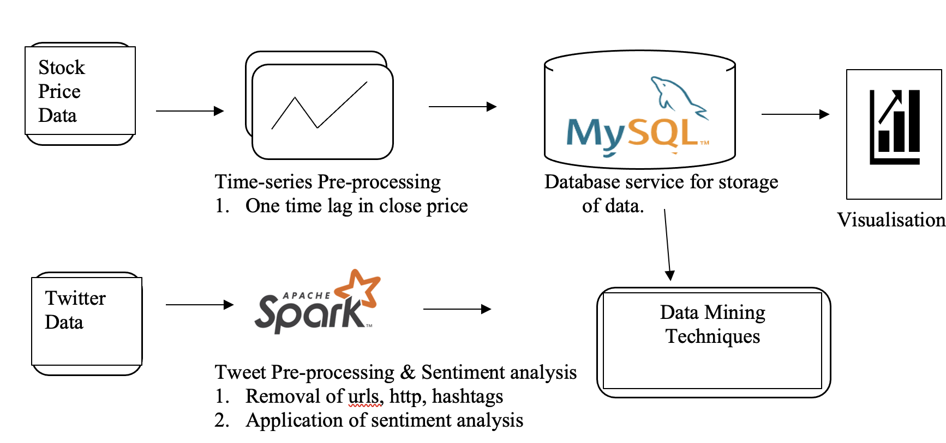
System Overview

Slide 6







Technologies used

Slide 7
Data Collection
Data used in this research are two type:
Tweets & stock price from Kaggle
Mysql database used to stock price data

Slide 8
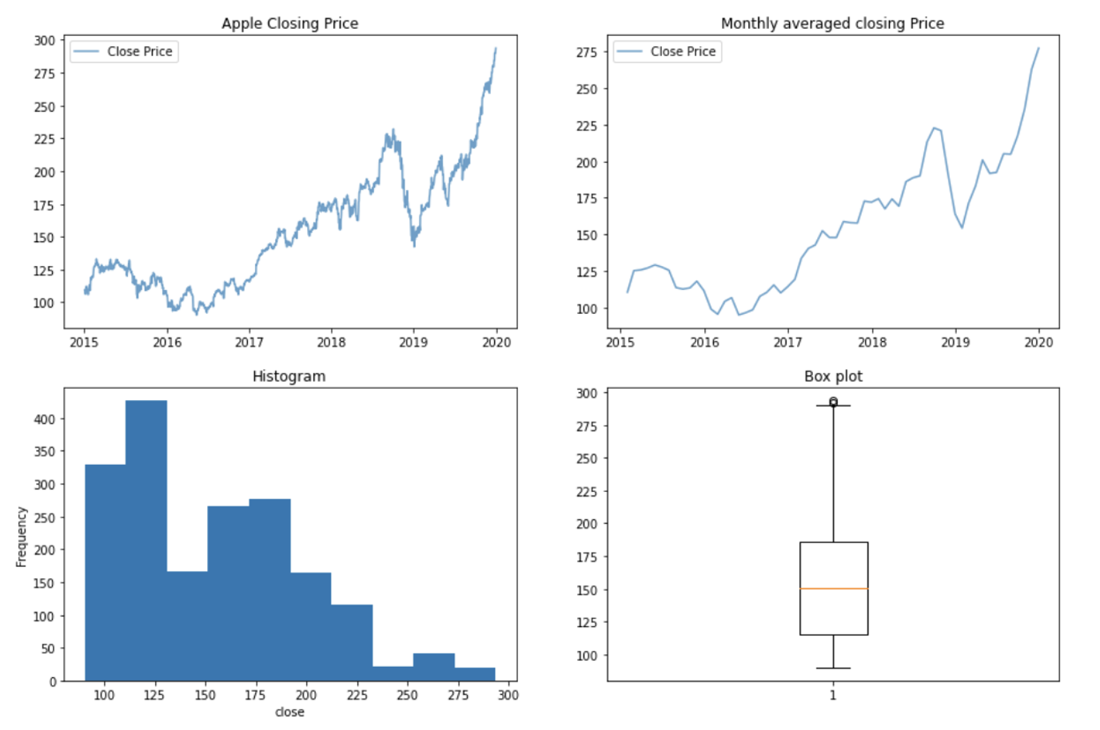
Data exploration

Slide 9
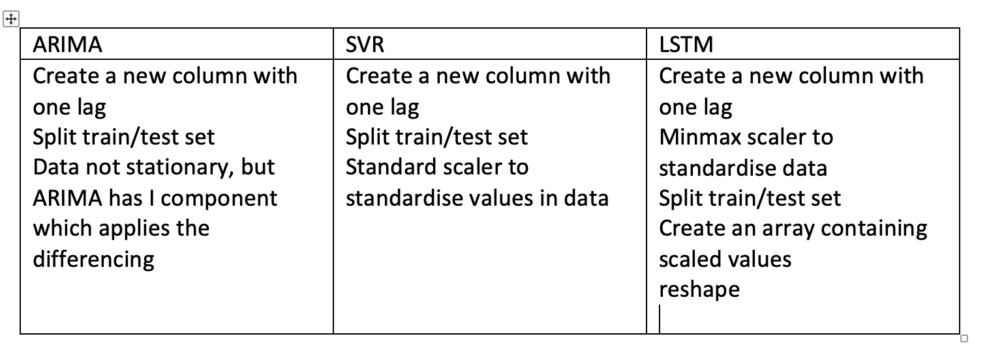
DATA PREPROCESSING of part a
Stock price data

Slide 10
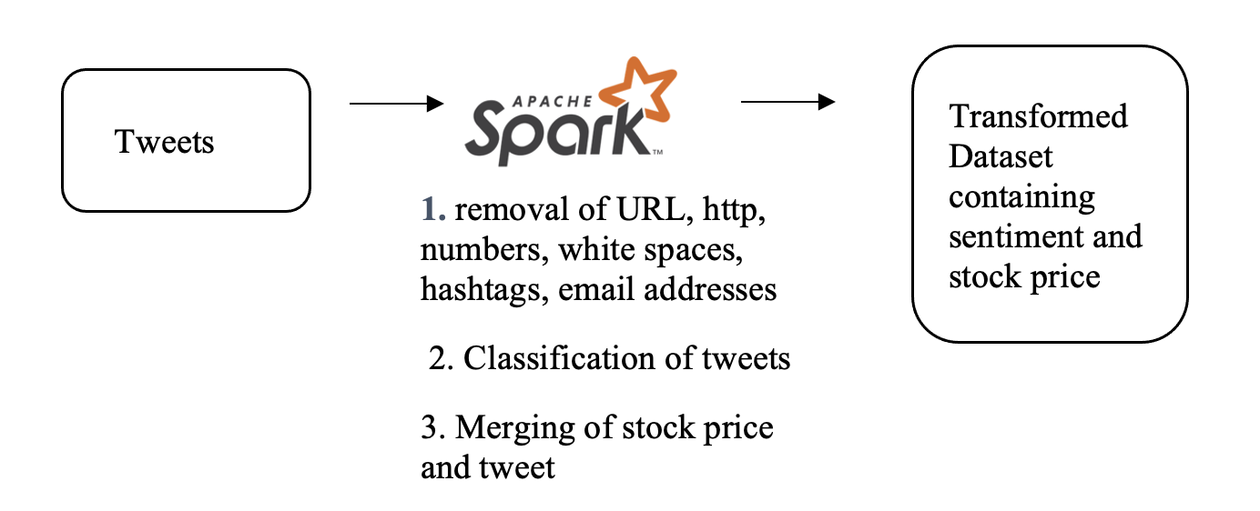
Data pre-PROCESSING of part b

Slide 11
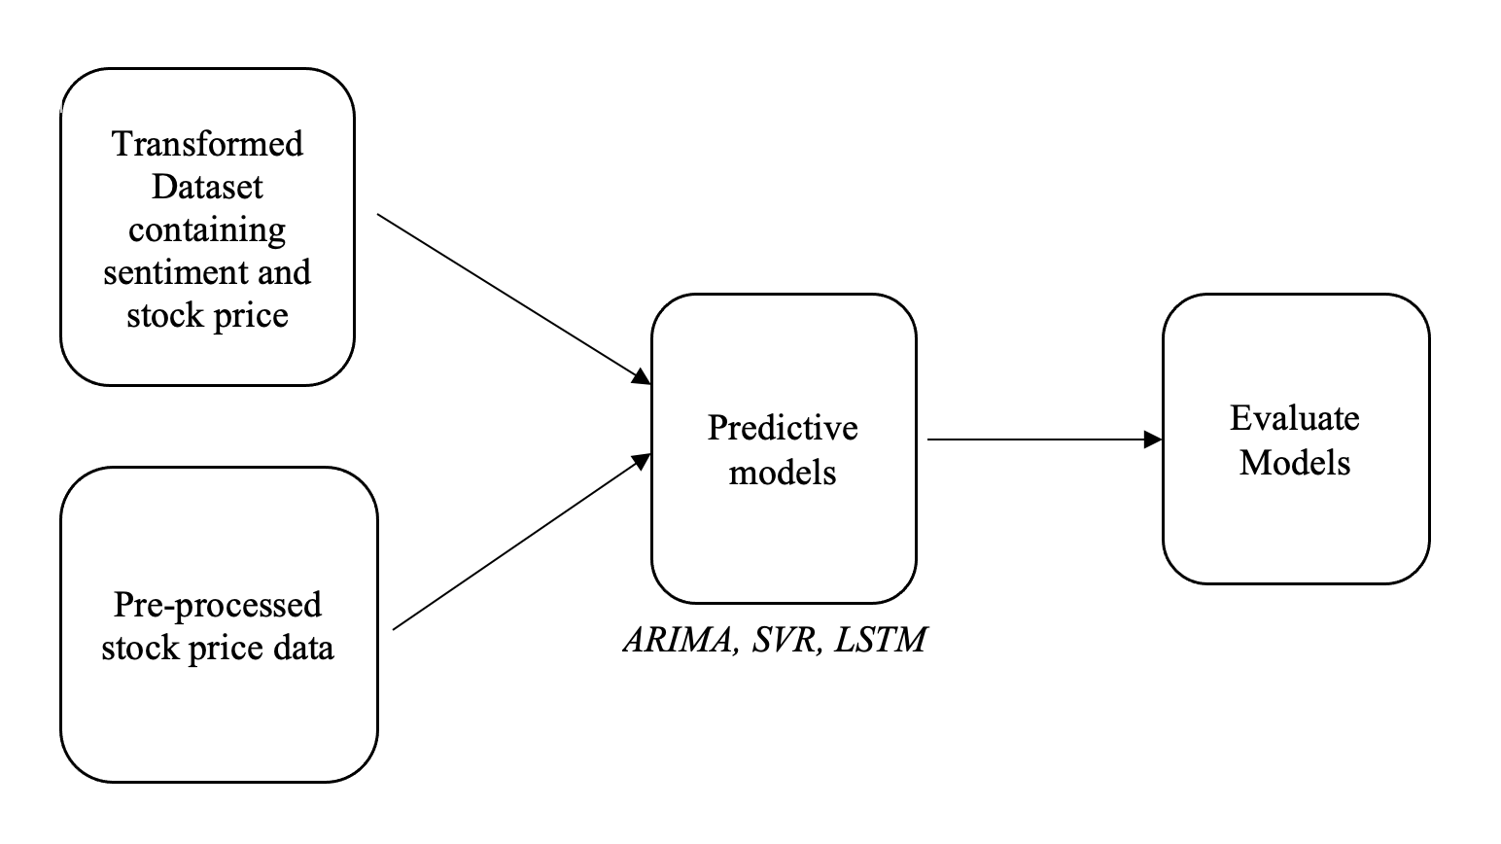
Research Process

Slide 12
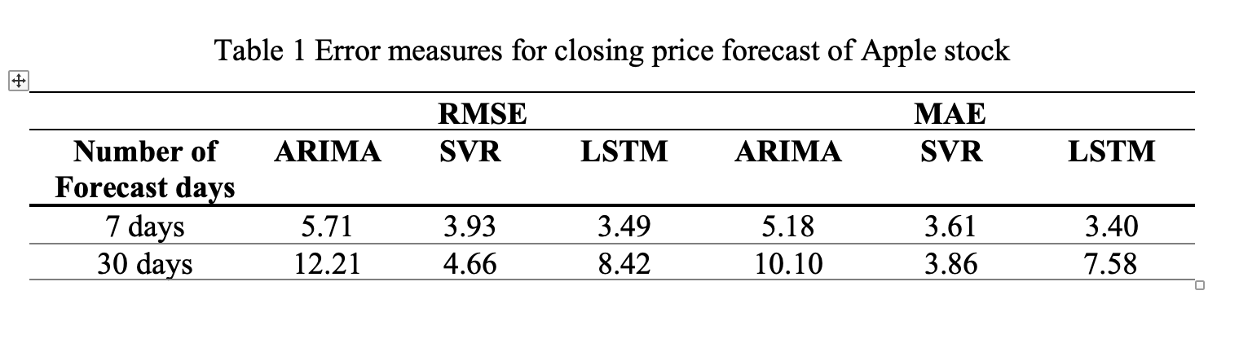
Part A results
Used the auto_arima function to find the best model with the lowest AIC
The best model was ARIMA (2,1,2)
The RMSE and MSE for 7-day prediction

Slide 13
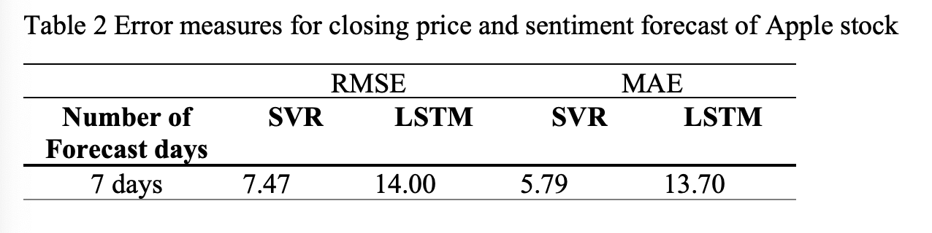
PART B RESULTS

Slide 14
Future tasks
To improve the learning models by providing it with a bigger dataset
Expand the stock to not only Apple, but also other stocks or bitcoin
To deploy the model on real trading system

